Slide 1
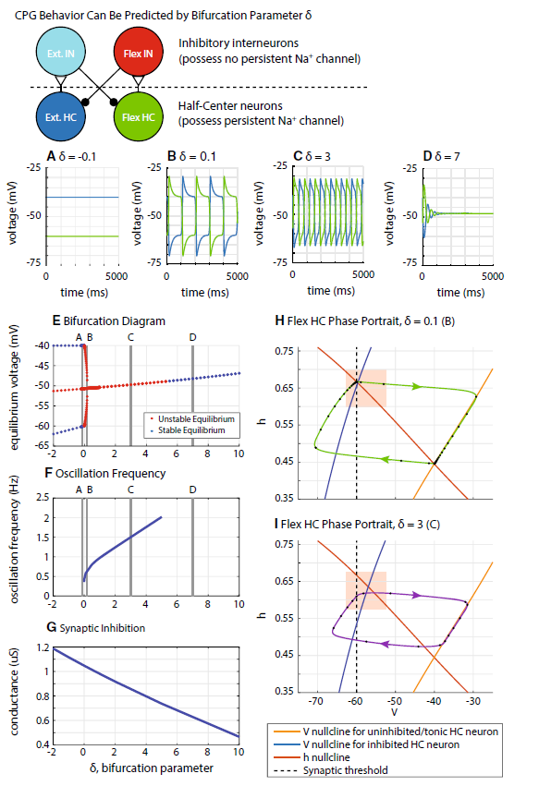
The dynamical system of two-layer CPG
Investigate how descending commands and conductance between oscillators influence the phase duration, phase plane and oscillation stability.
Related previous work:
Spardy et.al 2012
Szcecinski et.al 2017
Notes:
Green: h-nullcline
Blue: EXT V-nullcline
Red: FLX V-nullcine
Mega: Voltage threhold

Slide 2
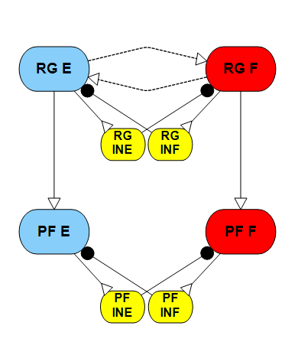


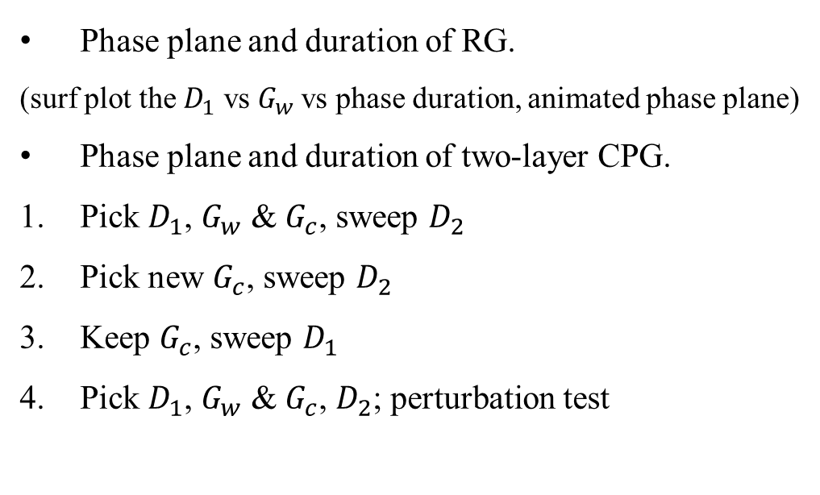



For Spardy’s work:
For Szcecinski ’s work:
Starts from single neuron activities.
Phase plane of CPG without feedback.
CPG with sensory feedback.
The CPG is not up-to-date.
PF reaction not explored.
Influence of conductance not investigated.
Half-Center response to bifurcation parameter.
CPG phase response curve (stimulus).
CPG with sensory feedback.
The CPG is single layer.
No supra-spinal drive.
Servo based model.
Experiment set up:
$$D_{1}$$
Phase plane and duration of RG.
(surf plot the $D_{1}$ vs $G_{w}$vs phase duration, animated phase plane)
Phase plane and duration of two-layer CPG.
Pick $D_{1}$, $G_{w}$ & $G_{c}$, sweep $D_{2}$
Pick new $G_{c}$, sweep $D_{2}$
Keep $G_{c}$, sweep $D_{1}$
Pick $D_{1}$, $G_{w}$ & $G_{c}$, $D_{2}$; perturbation test
$$G_{w}$$
$$G_{c}$$
$$G_{c}$$
$$D_{2}$$

Slide 3
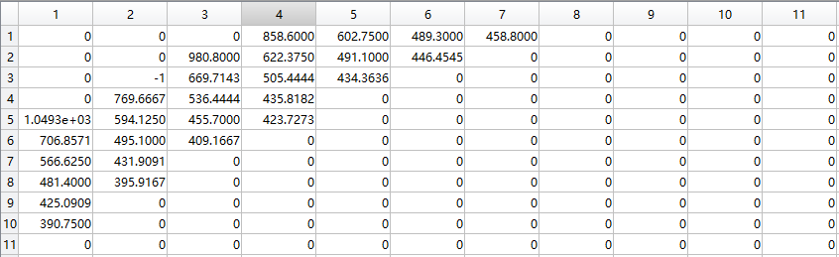
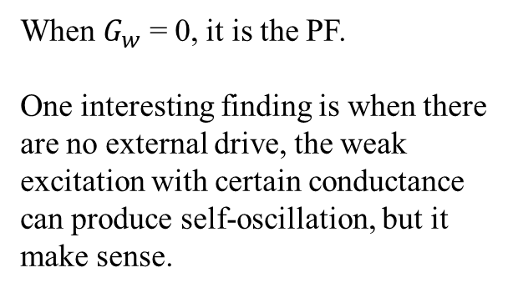


Surf plot the $D_{1}$ vs $G_{w}$vs phase duration for RG
$D_{1}$= 0:1:10 &$G_{w}$ = 0:0.1:1
Phase duration
When $G_{w}$ = 0, it is the PF.
One interesting finding is when there are no external drive, the weak excitation with certain conductance can produce self-oscillation, but it make sense.

Slide 4

Surf plot the $D_{1}$ vs $G_{w}$vs phase duration for RG
$D_{1}$= 0:10.:10 &$G_{w}$ = 0:0.01:0.7
Phase duration
This shows that Phase duration can be expressed in term of $D_{1}$ & $G_{w}$

Slide 5
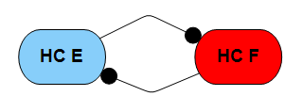
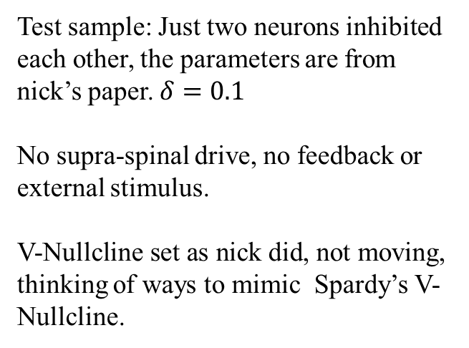
Phase plane for HC:
Test sample: Just two neurons inhibited each other, the parameters are from nick’s paper. $δ=0.1$
No supra-spinal drive, no feedback or external stimulus.
V-Nullcline set as nick did, not moving, thinking of ways to mimic Spardy’s V-Nullcline.

Slide 6
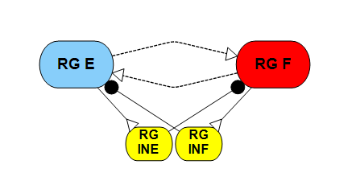



Phase plane for RG:
$$D_{1}$$
$$G_{w}$$
$D_{1}$= 3 &$G_{w}$ = 0.05
Fixing some problems and finding the equation and codes for the V-Nullcline.
Question:
In Animatlab, calcium channel are used instead of sodium channel.
Which paper are we trying to compare with, nick’s or Spardy’s (parameter choosing)

Slide 7
Outline for the dissertation proposal
A SNS Driven Musculoskeletal Model for Rat Hindlimb Locomotion
Goal: Investigate the control strategies of rat hindlimb locomotion with a neuromechanical model. The new SNS implements the up-to-date neurological hypothesis and biarticular muscle controls.
Aim 1 - Implement the hypothesized two-layer CPGs into the Synthetic Nervous System of rat hindlimb model. Reproduce the ‘non-resetting deletions’, study the stability with different perturbations.
(Done) Living Machines 2018 + Biomimetics 2019+ SfN 2018 (Torque perturbation)
Aim 2 - The dynamical system of two-layer CPG.
This content
Aim3 – Ground walking model with biarticular muscle model, perturbation tests.
Biomechanical part and Kinematic and Kinetic Analysis --- Living Machines 2020.
SNS part:
Result from Aim2 – CPG parameter set up
MN configuration design and parameter setting
Parameter tuning to produce ground walking.
Perturbation test

